Slide 1
Rank-Preserving Two-Level Caching for Scalable Search Engines
Saraiva, de Moura, Ziviani, Meira, Fonseca, Ribeiro-Neto
Venue: SIGIR’01
The Impact of Caching on Search Engines
Baeza-Yates, Gionis, Junqueira, Murdock, Plachouras, Silvestri
Venue: SIGIR’07

Slide 2
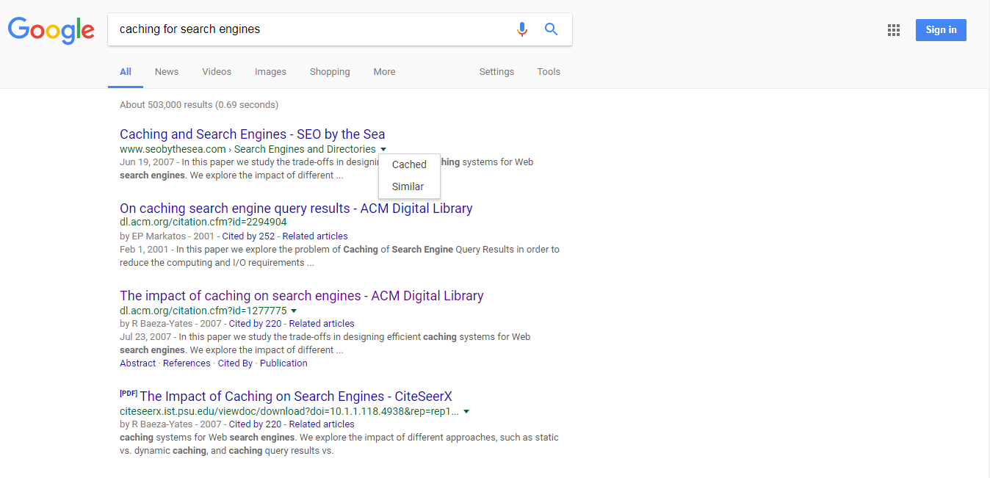
Why Caching?

Slide 3
Problem addressed in the Seminal Paper
Implement effective caching scheme to reduce the computing and I/O Requirements of a Web search engine without altering its rank characteristics

Slide 4
Problem Analysis in the Paper
TodoBR: A full scale operational Brazilian Search Engine
Compare set of log queries to measure and compare the performance and the scalability of the search engine for:
No cache
Cache for query results
Cache for inverted lists
Two-level cache

Slide 5
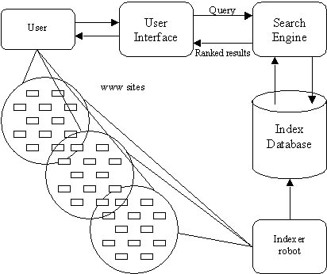
Basic Search Engine Architecture
Vector Space
Model(TodoBR)
Inverted
Files(TodoBR)
Image from: http://www.au-kbc.org/research_areas/nlp/projects/sengine.html

Slide 6
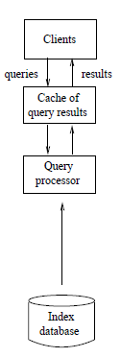
Cache for Query Results
Keep in memory the list of documents
associated with a given query
Store first 50 references
LRU is used for replacement of cache
query results

Slide 7
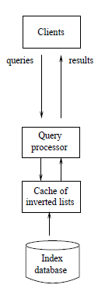
Cache of Inverted Lists
Keep in memory the list of web
documents associated with a given
query term
Organization of caching: Dividing into
blocks of documents and paging in
equal sizes
LRU is used for replacement of
inverted lists results

Slide 8
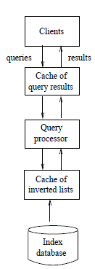
Two-Level Cache
Cache of query results avoids process-
ing queries which are already present
in the cache
Cache of inverted lists avoids disk
accesses

Slide 9
Comparison on Queries Processed to Fetched
Implementation | Processed Queries | Fetched Queries
No Cache | 100,256 | 4,508,684
Cache of Inverted Lists | 100,256 | 346,267
Cache of Query Results | 38,097 | 1,791,364
Two-level Cache | 46,118 | 356,267
Processed Queries: Two-Level Cache 62% lesser queries processed than No Cache and only 21% more than Cache of Query Results
Fetched Queries: Two-level Cache has only 3% increase in fetched queries than Cache of Inverted Lists

Slide 10
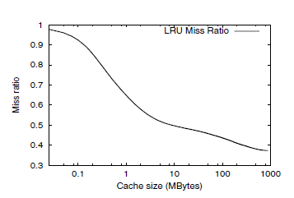
Determining the Cache Size for Query Results
Minimum miss ratio is around
40%, this is miss ratio that an
infinite cache would exhibit
Knee pattern in the graph
suggests a small fraction of
the queries account for a
significant portion of the
accesses
Knee Pattern: Good indicator
for cache size i.e. 20 MB

Slide 11
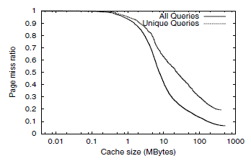
Determining the Cache Size for Inverted Lists
Miss ratio of “All Queries” <
“Unique Queries”
250 MB cache for inverted lists
of Unique Queries i.e. second
level cache has a hit ratio of
around 80% on top of the
misses at the first level

Slide 12
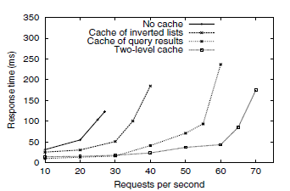
Average Response Time vs Request Rate
At 20 requests/sec, best perfor-
mance: Cache of Query Results
followed by Two-Level Cache

Slide 13
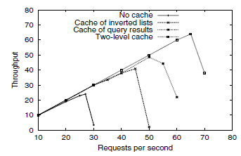
Throughput per Second
Results in Queries/Sec
Two-Level Cache: 64
No Query: 22
Cache of Inverted Lists: 42
Cache of Query Results: 47

Slide 14
Conclusion of the Seminal Paper
Maximum throughput for Two-Level Cache is three folds to No Cache, up to 52% higher than Cache of Inverted Lists and up to 36% higher than Cache of Query Results
Analysis of TodoBR logs indicates miss ratio of both the caches decrease as larger request streams are considered

Slide 15
Reasons for Choosing the Citing Paper
Uses LRU for dynamic cache building and outperform it by a static caching model
Caching query terms is more efficient than caching query results

Slide 16
Problems addressed in the Citing Paper
Comparing static and dynamic cache models
Comparing caching posting lists (query terms) to caching queries
Effect of compressed, uncompressed, partial and full index sizes on the average response time of the search engine
Effect of query dynamics over time

Slide 17
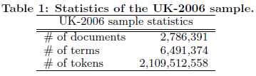
Dataset Used for Analysis
Query logs for an year
50% of the total number of queries were unique

Slide 18
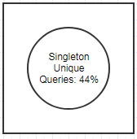
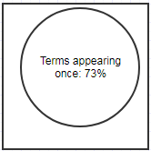
Why Caching of Terms over Caching of Queries
Total Queries
Total Vocabulary
Rest of Queries: 56%
Rest of Vocabulary: 27%
4% of the Query Log
Image drawn in: https://go.gliffy.com/go/html5/launch

Slide 19
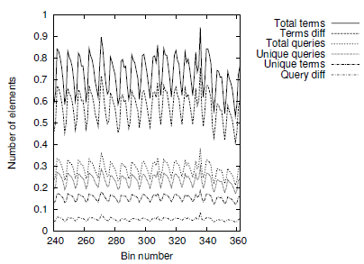
Arrival Rate for Terms and Queries
Volume of Terms > Volume of Queries
Difference between unique terms to total terms > Difference between unique queries to total queries

Slide 20
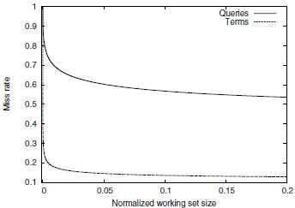
Miss Rate function of Working Set Size
sharp decay till 0.01
Minimum miss rate: 50%
(for Queries)
Minimum miss rate: 80%
(for Terms)

Slide 21
Algorithms considered for Analysis
Dynamic Algorithms
Least Recently Used (LRU)
Least Frequently Used (LFU)
Dynamic-QtfDf
Static Algorithms
QTF
QtfDf

Slide 22
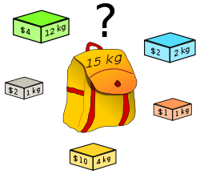
Knapsack Problem (Basis for Qtf-Df)
Figure from: https://en.wikipedia.org/wiki/Knapsack_problem

Slide 23
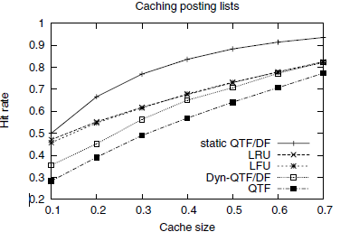
Hit Rate vs Cache Size (Caching Posting Lists)

Slide 24
Conclusion of Citing Paper
Dynamic caching of queries has limited effectiveness due to compulsory misses caused by unique or infrequent queries
Caching queries has a miss rate of 50% to Caching terms which have a miss rate of around 12%
Static caching algorithm outperforms dynamic algorithms such as LRU and LFU by 10% in hit rates

Slide 25
Effects of Compressing Caching on Response Time
Full/Uncompressed
Partial/Uncompressed
Full/Compressed
Partial/Compressed
Decreasing order of
Response Time

Slide 26
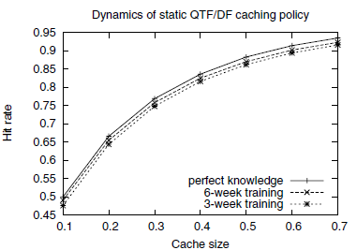
Effects of Query Dynamics

